Slide 1
Chronic kidney disease
Madhusudan Upadya
Kasturba Medical College,
Mangalore
And anesthesia

Slide 2
Introduction
CKD is still an underdiagnosed but highly prevalent disease associated with worse postoperative outcomes.
Patients with CKD are highly susceptible for further deterioration of renal function.
Perioperative goals are risk stratification, maintenance of hemodynamic stability.

Slide 3
Definition of ckd

Slide 4
Kidney Disease: Improving Global Outcomes (KDIGO)workgroup
CKD is classified based on cause, GFR, and albuminuria category if these are present for more than 3 months (if symptoms do not last longer than 3 months, the diagnosis of CKD is not established and tests should be repeated).
Divides CKD into 5 groups.

Slide 5
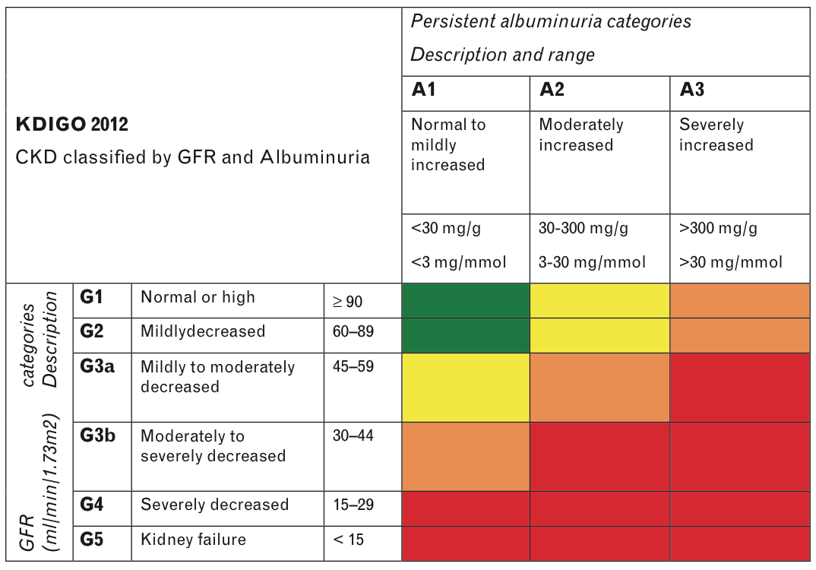
Definition of ckd
Green, low risk (if no other markers of kidney disease, no chronic kidney disease);
Orange, high risk;
Red, very high risk;
Yellow, moderately increased risk.

Slide 6
Etiology of chronic kidney disease

Slide 7
Primary kidney diseases
Systemic
diseases
Diabetes,
Systemic autoimmune diseases,
Systemic infections,
Drugs,
Neoplasia
Diffuse, focal or crescentic proliferative glomerulonephritis;
Focal and segmental glomerulosclerosis,
Membranous nephropathy,
Minimal change disease
Glomerular diseases
Etiology of chronic kidney disease

Slide 8
Primary kidney diseases
Systemic
diseases
Systemic infections, autoimmune, sarcoidosis, drugs, urate, environmental toxins, neoplasia
Urinary-tract infections,
Stones,
Obstruction
Tubulointerstitial diseases
Etiology of chronic kidney disease

Slide 9
Primary kidney diseases
Systemic
diseases
Atherosclerosis, hypertension, ischemia, cholesterol, emboli, systemic vasculitis, thrombotic microangiopathy, systemic sclerosis
ANCA-associated renal limited vasculitis, fibromuscular dysplasia
Vascular diseases
Etiology of chronic kidney disease

Slide 10
Primary kidney diseases
Systemic
diseases
Polycystic kidney disease, Alport syndrome, Fabry disease
Renal dysplasia, medullary cystic disease, podocytopathies
Congenital diseases
Etiology of chronic kidney disease

Slide 11
chronic kidney disease screening

Slide 12
Clinical factors
Diabetes
Hypertension
Cardiovascular diseases
Obesity
Autoimmune diseases
Systemic infections
Exposure to certain drugs
Recovery from acute kidney injury
Family History of chronic kidney disease

Slide 13
Systemic manifestations of ckd

Slide 14
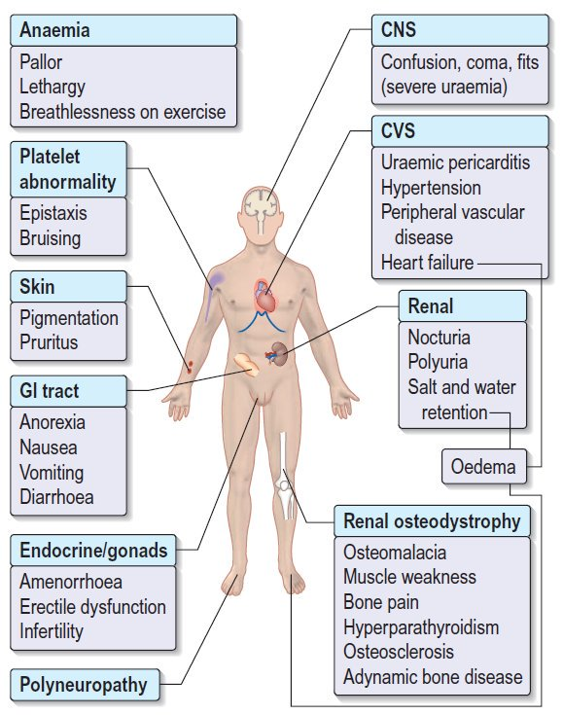

Slide 15
Clinical problems in patient with end stage renal disease
System | Clinical problems
Cardiovascular | Atherosclerosis; Hypertension; Coronary artery disease; Arrhythmias; Cardiomyopathy; Congestive cardiac failure; Pericarditis; Pericardial effusion
Respiratory | Pulmonary edema; Pleuritic; Pleural effusion; Pneumonia; Atelectasis
Hematological | Normocytic normochromic anaemia; Impaired platelet function
Liver | Hepatitis; Hypoalbuminemia
Gastrointestinal | Peptic ulcer disease; Nausea; Vomiting; Pancreatitis

Slide 16
Clinical problems in patient with end stage renal disease
System | Clinical problems
Immunological | Impaired immunity; Wound healing
Endocrine | Glucose intolerance; Secondary hyperparathyroidism
Musculo-skeletal | Renal osteodystrophy; Metastatic calcification
Nervous system | Peripheral neuropathy; Seizures; Coma; Autonomic neuropathy

Slide 17
Preoperative assessment and optimization

Slide 18
Investigations
Complete blood counts
Coagulation profile
Urea
Creatinine
Electrolytes
Liver function tests
Electrocardiography
Chest radiogram
Echocardiography

Slide 19
Special workup
Investigations for coronary artery disease – in all patients with ESRD, esp in patients with DM
Dobutamine stress echocardiogram

Slide 20
Strategies for preoperative preparation
Correction of Anemia
Control of Hypertension
Correction of Coagulopathy
Correction of Hyperkalemia
Preoperative Hemodialysis

Slide 21
Recombinant erythropoietin (EPO)
Rise of hemoglobin to target level at least 10 g/dl
Decreases postoperative transfusion requirement
Caution: worsening of hypertension, risk of CVA
Preop Hemodialysis
Within 24 hours prior to surgery
Reduce risk of hypervolemia, hyperkalemia and increased bleeding
Keep post dialysis weight near to the dry weight of the patient – to avoid hypovolemia post-HD

Slide 22
Mx. of delayed gastric emptying (stress, uremia, diabetes mellitus etc )
H2 receptor antagonists
Proton pump inhibitors
Prokinetic drugs like metoclopramide
Magnesium and aluminum containing antacids should be avoided
Rapid sequence induction
Rule out infections
Susceptible due to uremia, associated comorbidities like diabetes, coupled to donor related acquired infection and therapeutic immunosuppression (in renal transplant recipients)

Slide 23
Antihypertensive and antianginal medications
are to be continued till morning of surgery
Oral hypoglycaemic agents
Discontinued on the day of surgery
Consider conversion to regular insulin regime

Slide 24
Low levels of albumin due to
Plasma volume expansion
Albumin redistribution
Exogenous loss (in peritoneal dialysis patients)
Decreased albumin synthesis.
Low blood albumin level predisposes to increased free fraction of drugs
Uremia leads to disruption of blood brain barrier
Exaggerated effect of the anesthetic agents
Dose modification in CKD
Volume status
Acid base status
Increased CNS sensitivity

Slide 25
Other concerns
Record patient’s weight – idea regarding volume status
Venous access may be difficult
Care of AV fistula
Careful positioning
Renal osteodystrophy (fragile bone and joints)
Skin integrity diminished (susceptible to pressure-related injuries)
Sensory neuropathy

Slide 26
Other concerns
Hypothermia-
Increase ambient temperature in OR
Heated humidifier to warm and moisten inspired gas
Forced-air convection blanket
IV fluid warmers
Increased risk of hepatitis and HIV in dialyzed patients
Universal precautions
Check serology reports

Slide 27
Nephroprotective strategies
Goal | Target
Discontinue all nephrotoxic agents | Consider avoiding radiocontrast agents Avoid colloids if possible
Ensure volume status and perfusion pressure | SVV < 11 Mean arterial pressures > 65 mmHg (higher values in patients with hypertension) CVP 8–12mmHg Measure blood lactate levels ScvO2 > 70% Intra-abdominal pressure < 15 mmHg
Consider functional hemodynamic monitoring | Functional leg raising, Invasive blood pressure monitoring, TTE, TEE, PICCO in major surgeries
Monitor serum-creatinine and urinary output | Serum-creatinine daily and urinary output hourly
Avoid hyperglycemia | Blood glucose levels 110 – 150 mg/dl

Slide 28
Anesthetic agents in renal failure

Slide 29
Key concerns
Drugs excreted unchanged by kidney
Degree of protein binding (hypoalbuminemia)
Increase in volume of distribution (prolong elimination half-life)
Metabolic acidosis (more un-ionized, non-bound, active form of weakly acidic drugs)
Nephrotoxicity of drugs used

Slide 30
Induction agents and sedatives
Induction with thiopentone, propofol or etomidate using slow titrated doses can be done.
More sensitive to benzodiazepines and tranquilizers
Dexmedetomidine – primarily metabolized in liver; less protein binding in CKD

Slide 31
Induction agents and sedatives
Opioids
Short acting opioids like fentanyl or remifentanil
Morphine should be carefully used
morphine-6-glucuronide, its active metabolite can accumulate
can lead to respiratory depression

Slide 32
Muscle relaxants
Succinyl choline
used with caution
it can lead to hyperkalemia, especially when initial potassium levels >5 meq/l
Atracurium, Cisatracurium, Vecuronium, Rocuronium and Mivacurium can be safely used.

Slide 33
Inhaled anesthetics
Reversal of CNS effects – dependent on pulmonary excretion
May cause transient reversible depression in renal function
Isoflurane is commonly considered agent of choice as minimal amount of it is metabolised and there is reduced production of fluoride ions
Studies have failed to show advantage of one agent over the other

Slide 34
analgesics
NSAIDs should be avoided
Acetaminophen – can be safely used
lifetime cumulative doses of acetaminophen do not have an adverse effect on CKD progression rate
Weak opioid e.g. codeine phosphate or tramadol
Reduced doses are advisable in patients with eGFR<30, monitor closely for signs of toxicity

Slide 35
anticholinesterases
Prolonged duration of action
? “Recurarization” after reversal of NMBD in renal failure
Rule out other causes

Slide 36
Potential problems during emergence
Delayed recovery
Hypertension
Respiratory depression
Pulmonary edema
Vomiting, Aspiration

Slide 37
Role of regional anesthesia

Slide 38
Preloading
Both volume and type of fluid – decided on case-to-case basis
Hemodynamic instability
Sympathetic block super imposed on autonomic dysfunction
Coagulopathy
Concerns with neuraxial blockade
Catheter-site infection
Postoperative sensory blockade should be followed up.

Slide 39
Perioperative kidney injury

Slide 40
Identification of patients at risk of developing acute kidney injury
Hemodynamic goals – to prevent organ hypoxia
Avoid a low MAP, even for a short period of time
Urine output does not predict postoperative AKI.
Avoid nephrotoxic drugs
Careful selection and use of IV fluids and vasopressors and appropriate blood management

Slide 41
Summary and conclusion

Slide 42
A strict preoperative evaluation and optimization can reduce morbidity and mortality.
Optimization of the patient with renal dysfunction need not only consider pre-existing renal function but also can reduce the possibility of acute kidney injury (AKI) in the post-operative period.

